Slide 1

1e Sprint Review
Arcade mechenics

Slide 2


Inleiding
samenwerken
Blender
Unity

Slide 3
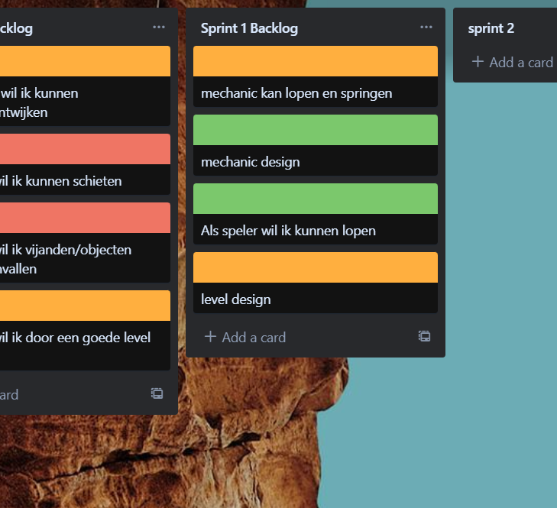
Samenwerken
Taken
Git
Trello

Slide 4
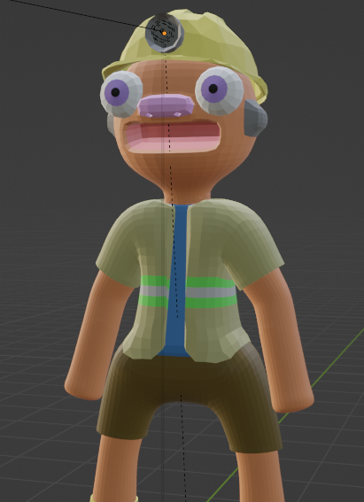
Blender
Player
Level
Weapon

Slide 5
Unity
Physics
C#
movement

